Slide 1

Zephyr Workshop: Console, Logs & Shell
A hands-on guide to understanding output mechanisms, logging systems, and runtime interaction in the Zephyr RTOS environment

Slide 2

What is the Console in Zephyr?
The console subsystem in Zephyr provides an abstraction layer for where text output is sent from your application. By default, output is directed to a UART (serial port), but the system is flexible:
UART (Universal Asynchronous Receiver/Transmitter) - default
USB CDC (Communications Device Class)
Dummy console for testing or systems without output
Telnet for network-connected devices
Functions like printk() and the various logging macros utilize the console backend to display their output.

Slide 3
What is the Logging Subsystem?
Structured Reporting
Severity Levels
Module-Based Configuration
Zephyr's logging subsystem provides a structured and consistent way to report messages throughout your application. This enables better organization and filtering of output.
Messages can be categorized by importance:
Each module in your application can have its own log level, allowing for fine-grained control over verbosity. Output is directed to the configured console backend.
LOG_ERR - Critical errors that prevent operation
LOG_WRN - Warning conditions requiring attention
LOG_INF - Informational messages about normal operation
LOG_DBG - Detailed debug information

Slide 4
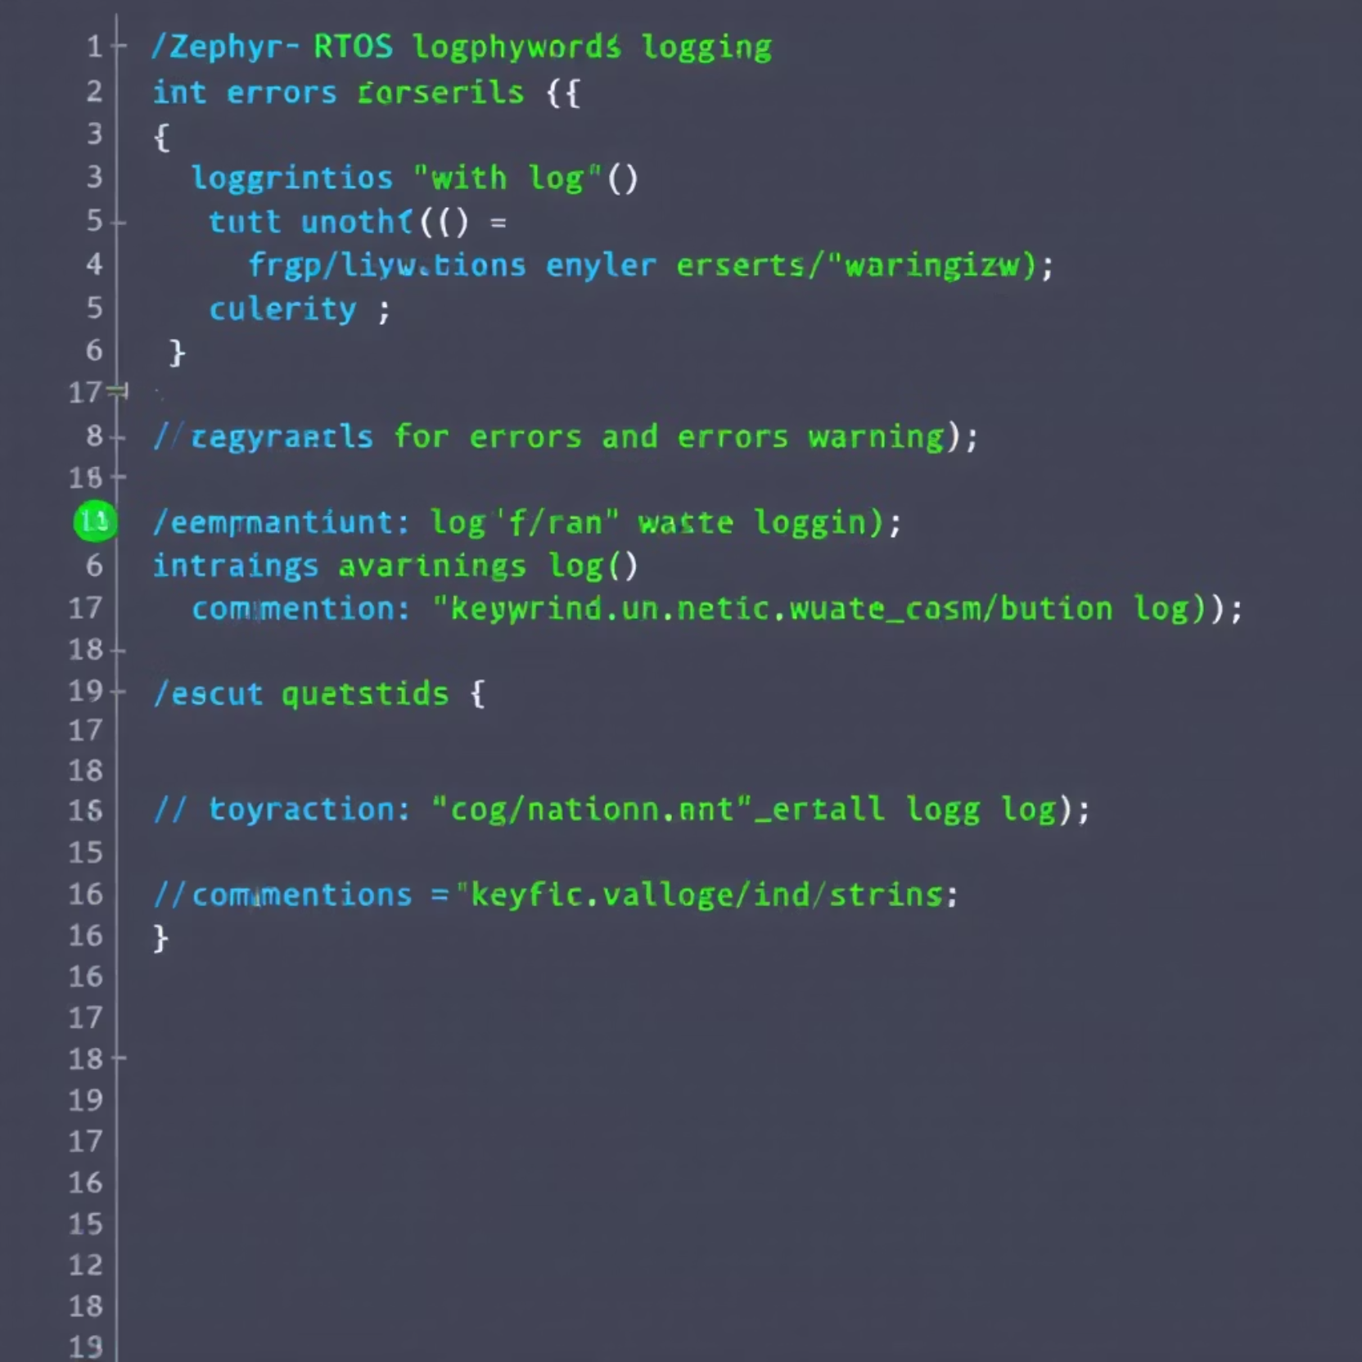
Logging Setup Example
Configuration (prj.conf)
CONFIG_LOG=y
CONFIG_LOG_MODE_DEFERRED=y
CONFIG_LOG_BACKEND_UART=y
Code Implementation (main.c)
#include <zephyr/logging/log.h>
LOG_MODULE_REGISTER(tmp102sample);
Replace standard print statements with logging macros:
// Before: printk("Temperature: %d\n", temp);
// After: LOG_INF("Temperature: %d", temp);
The deferred mode buffers log messages and processes them later, which is less intrusive to timing-sensitive code. The UART backend ensures messages appear on the serial console.

Slide 5



What is the Shell Subsystem?
Interactive Command-Line
Runtime Control
Extensible Commands
The Shell subsystem provides an interactive command-line interface over UART or USB connections, allowing real-time control and monitoring of your application.
Shell enables dynamic interaction with your application without recompilation. This is invaluable for debugging, testing, and runtime configuration adjustments.
Developers can leverage built-in commands or create custom commands specific to their application's needs, providing a powerful interface for system monitoring and control.

Slide 6

Shell Backend (Console Link)
The Shell subsystem uses the same backend infrastructure as the console, creating a consistent interface for both programmatic and interactive output:
Shell commands and responses flow through the configured console backend
Most commonly used with CONFIG_SHELL_BACKEND_SERIAL for UART-based shells
Can share the same physical interface as application logging
Other option are BLE, USB, RTT, etc…

Slide 7
Shell Setup in prj.conf
Enable Shell Subsystem
Configure Console
CONFIG_SHELL=y
CONFIG_UART_CONSOLE=y
Directs console output to the system's UART interface, typically connected to a serial terminal on your development computer.
This activates the shell framework and core functionality, including command parsing, history, and tab completion.
Set Shell Backend
Enable Basic Output
CONFIG_SHELL_BACKEND_SERIAL=y
CONFIG_PRINTK=y # Optional
Configures the shell to use the serial (UART) backend for interactive command input and output.
Enables the printk() function for basic output messages through the console.

Slide 8
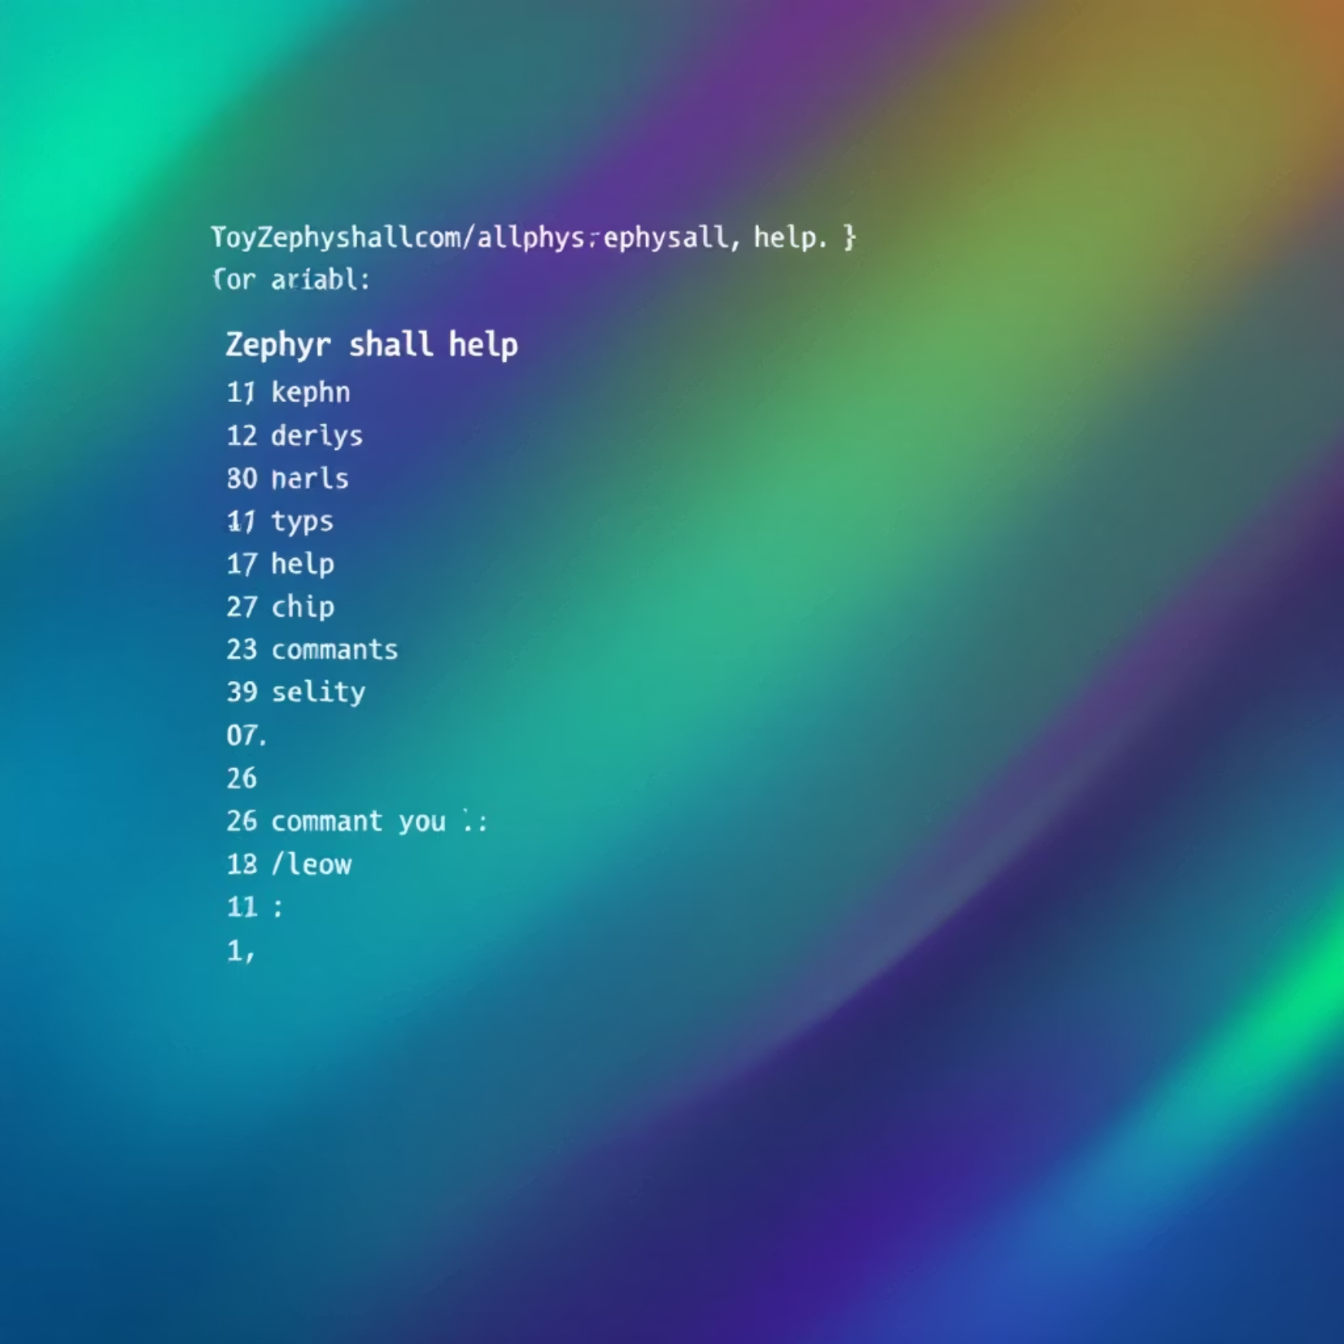
Built-in Shell Commands
Zephyr's shell comes with several useful built-in commands:
help
Lists all available commands or provides details on specific commands
kernel
Displays thread information, uptime, and other kernel statistics
device
Shows all initialized device drivers in the system
Controls and views logging levels for different modules
log
version
Shows the Zephyr version information
resize
Adjusts the terminal dimensions for proper formatting

Slide 9

Creating a Custom Shell Command
Adding your own commands to the shell is straightforward using the SHELL_CMD_REGISTER() macro:
static int cmd_my_command(const struct shell *shell, size_t argc, char **argv)
{
shell_print(shell, "Command executed!");
return 0;
}
SHELL_CMD_REGISTER(mycommand, NULL, "My custom command description", cmd_my_command);
The function signature requires:
A pointer to the shell instance
The argument count (argc)
An array of argument strings (argv)
Commands can be organized in subcommand groups using SHELL_STATIC_SUBCMD_SET_CREATE() for more complex command hierarchies. Use shell_print() to display output to the user.

Slide 10
Shell Command Example
Study Existing Examples
Examine Zephyr's built-in command implementations in kernel_service.c and sensor_shell.c to understand best practices for command design.
The examples in these files demonstrate advanced features like parameter validation, subcommand handling, and formatting output for better user experience.

Slide 11
Live Activity
Add shell command to your project (Sensor sample)
- Create activate command that will get an temperature as argument
- If the current temperature is higher than the argument print "it's too hot"
- Run and verify over UART shell

